Slide 1

Used Car Price Prediction
Problem Type: Regression.

Slide 2
Project Layout.
Dataset Description.
Raw Data Cleaning.
Data Cleaning with EDA.
Model Building
1. Linear Regression
2. Random Forest Regressor
Evaluating Both Model and Compare them.
Web App Creation with streamlit.
Deployment on Internet.

Slide 3
1. Dataset Description.
The Dataset have 4346 numbers of car records. And have 8 column, information contain about the car.
‘Brand’ – This column have the information about the car brand. From which brand the car is belong. It is Categorical Column
There is total 7 brand in the dataset.
‘Body’ – The body type of the car. Weather it is van or family car. Categorical column.
There is total 6 type of body type have in this data set. Like ‘sedan’, ‘van’
‘Mileage’ – How much the car has driven before. In miles. Here are numbers, integer type column.
‘EngineV’ – The engine volume of the car. This is also number column,
‘Engine Type’ – By which fuel or gas the engine is run,
weather it petrol or diesel. Categorical column.
‘Registration’ – The car have registration paper or not.
Only ‘yes’ or ‘no’
‘Year’ – The year of manufactured of the car. From 1989 to 2016 care are available.
‘Model’ – The specific model of the car correspond of it’s Brand. There are various model wither brand. Categorical column
‘Price’ – The target column. The price of the car is based on above information.

Slide 4
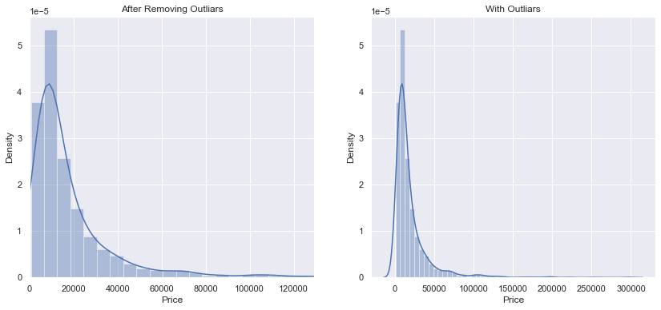
Raw Data Cleaning.
Check the distribution of the numerical column and based on that perform data pre-processing.
The numerical columns almost all of them have outliears values, I used quantile method to take quantile value(99th percentile) for a particular column
This process have done on ‘Price’. ‘Mileage’, ‘EngineV’ and ‘Year’ column. All of them were numerical columns.

Slide 5
Data Cleaning with EDA. For Linear Regression.
First I decided to build the machine learning model with Linear Regression. And for doing that I have to make some assumptions true for using Linear regression.
Like Linear regression is will work if there is linear relationship with target variable. If there is linear relation then the model may not work as expected.
First I remove the null value that were present on the data. That was below 5% of total data, so I simply remove those rows.
I check the distribution of the ‘Price’ column or my target column with numerical feature only. I did not check with any categorical column like ‘Brand’ or ‘Model’ column because those will be converted in to numerical encoding. There is no meaning to check the assumptions with categorical column.
Then I perform log-transformation on ‘Price’ column to make the relation linear.
I also removed the ‘Year’ column due to multicollinearity problem. As this feature were too much correlated with other features. So it will downgrade other feature weights. That is why I have to remove that column. I used Variance inflation factor for checking the multicollinearity.
Then I create dummy variable for categorical column. I used pandas ‘get_dummies()’ method for numerical encoding.

Slide 6
Data Cleaning with EDA. For Random Forest Regressor.
Random Forest is a ensemble technique for creating ml model. And it is very powerful for both classification and regression problems.
As it is tree based model it does not required not much data cleaning and data preprocessing.
I have only cleaned the data with removing the outliers and and remove the null values.
Then I use categorical encoding to convert the categorical columns in to numbers. I have used ‘sklearn’ ’s ‘labelEncoder()’ methode to perform the label encoding. It simply create number for categorical value for a column and for keeping that I have to put them in new column.
Then I go for model building process.

